Slide 1


From Raw Data to Insights: A Python, SQL, and Tableau Data Journey
Ana-Maria Paraschiv

Slide 2

Unveiling the Power of Data Science
Data Science is an interdisciplinary field that combines mathematics, statistics, machine learning, and computer science to solve complex problems, make informed decisions, and predict future outcomes.
Finance
Healthcare
Logistics
Retail
Manufacturing
Social Media
Data Science is not just about crunching numbers; it is about storytelling, communication, and problem-solving.

Slide 3


Predicting Absenteeism from Work
The problem: Absenteeism at a company during work time.
We would like to know whether an employee can be expected to be missing for a specific number of hours in a workday.
Access to such information in advance can enhance decision-making by enabling the reorganization of work processes to prevent productivity losses and improve work quality.

Slide 4




Problem-Solving Strategy
Integration of 3 powerful tools:
Python
SQL
Tableau
getting the optimal output from the analysis
STEPS:
Data Preprocessing using Python;
Applying the Logistic Regression method using Python to make predictions based on the data;
Storing the predicted outputs in a SQL Database;
Analyzing the predicted outputs in Tableau.
! We will be using CSV files for exchanging information between the tools.

Slide 5

Python: “The Data Scientist's Swiss Army Knife”
Characteristics:
Ease of Learning and Readability
Extensive Libraries
Open-Source
Vast and Supportive Community
Capability of Integration
Applications:
Data Analysis and Visualization
Machine Learning and AI
Web Develpoment
Game Development
Automation
“Python empowers data scientists to cut through complex datasets, slice and dice them with ease, and extract valuable insights.” — Wes McKinney, Creator of Pandas library

Slide 6




Data Preprocessing
= group of operations that will convert the raw data into a format that is easier to understand, and useful for further processing and analysis.
Pandas = popular Python's library that possess various tools for handling data in a tabular format (Pandas DataFrame).
! The Python code will be stored on Jupyter Notebook (*.ipynb file).
+

Slide 7
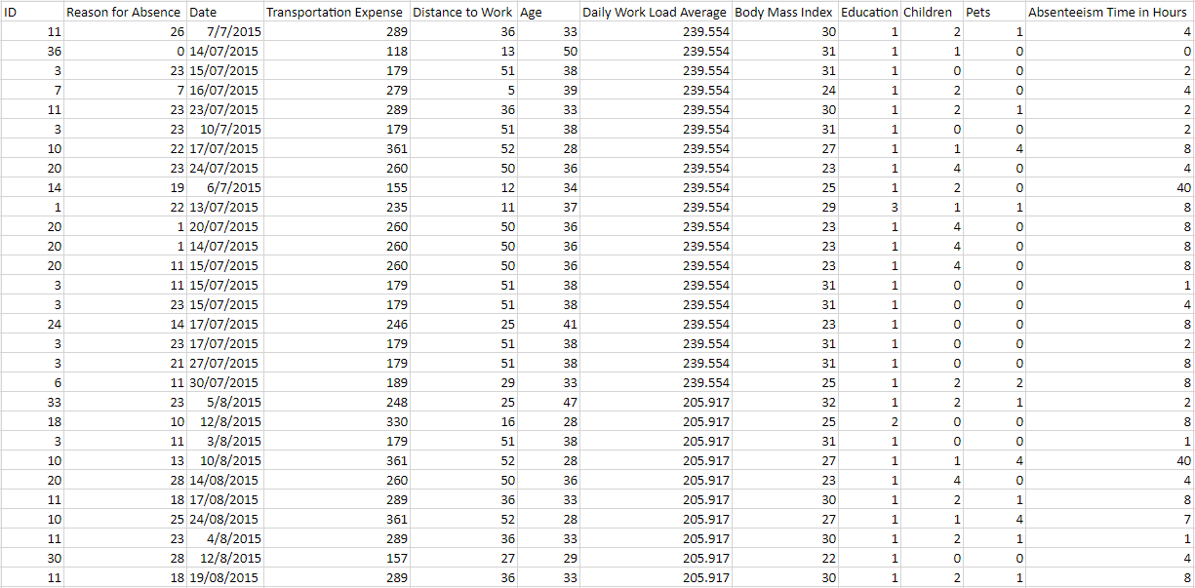

The Initial Dataset
700 rows x 12 columns
Source: The Business Intelligence Analyst Course, https://www.udemy.com/course/the-business-intelligence-analyst-course-2018/?kw=the+business+intelli&src=sac

Slide 8
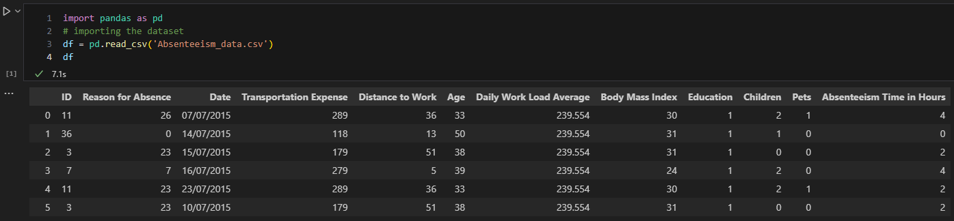
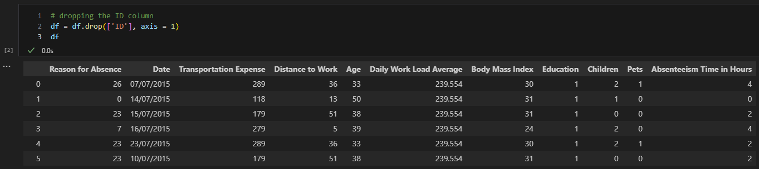
Importing the Dataset
DataFrame
2. Dropping the ID column

Slide 9
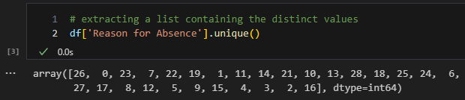
3. Extracting the Reason for Absence column for examination
28 different values of reasons for absence
Legend of the explanations of all reasons for absence
0 – Unjustified absence; 1 – Certain infectious and parasitic diseases; 2 – Neoplasms; 3 – Diseases of the blood; 4 – Endocrine, nutritional and metabolic diseases; 5 – Mental and behavioral disorders; 6 – Diseases of the nervous system; 7 –Diseases of the eye; 8 – Diseases of the ear; 9 – Diseases of the circulatory system; 10 – Diseases of the respiratory system; 11 – Diseases of the digestive system; 12 – Diseases of the skin; 13 – Diseases of the musculoskeletal system; 14 – Diseases of the genitourinary system; 15 – Pregnancy and childbirth; 16 – Maternity leave; 17 – Congenital disorders; 18 –Symptoms, signs, and abnormal clinical and laboratory findings; 19 – Injury, poisoning and certain other consequences of external causes; 20 – External causes of morbidity; 21 – Factors influencing health status; 22 – Patient follow-up; 23 – Medical consultation; 24 – Blood donation; 25 – Laboratory examination; 26 – Kinesiotherapy; 27 – Physiotherapy; 28 – Dental consultation.
Reasons 1 to 14 – related to various diseases -> Group 1
Reasons 15 to 17 – related to pregnancy and giving birth -> Group 2
Reasons 18 to 21 – related to injury, poisoning and others -> Group 3
Reasons 22 to 28 – light reasons for absence -> Group 4

Slide 10
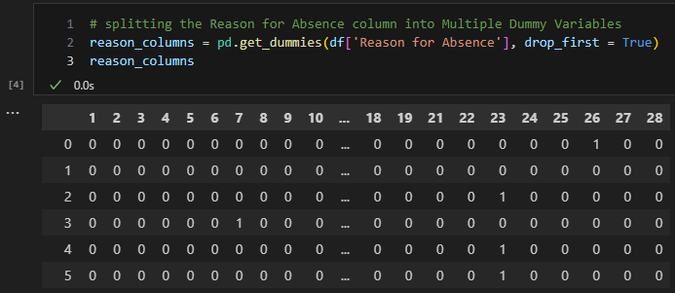
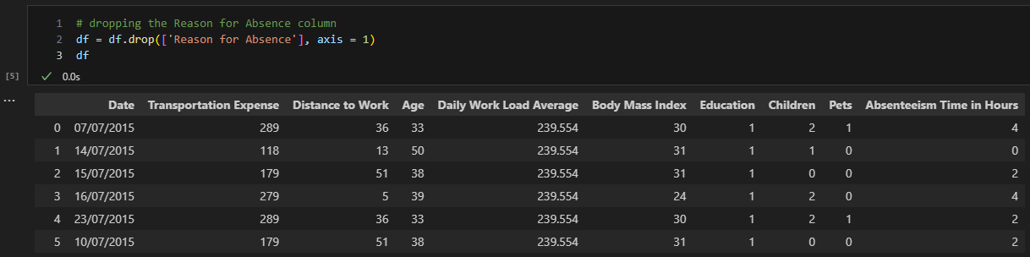
4. Splitting the Reason for Absence column into Multiple Dummy Variables
Dropping the unnecessary Reason 0 column
! We will be conducting the analysis for the reasons we are aware of, because we want to explore whether a specific known reason for absence induces an individual to be excessively absent from work.
Dummy Variable:
Equals 1 if a certain reason is present;
Equals 0 if a certain reason is absent.
5. Dropping the Reason for Absence column

Slide 11
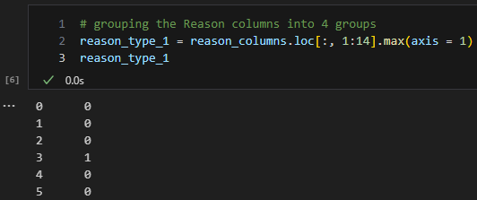
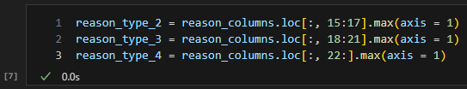
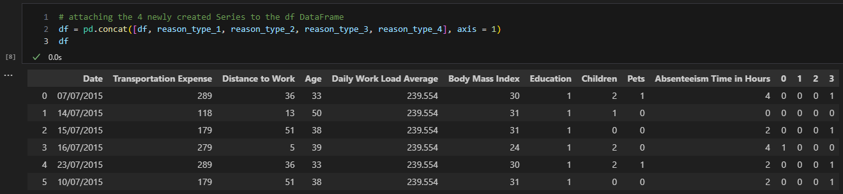
6. Grouping the Reason columns into 4 groups
Pandas Series
7. Attaching the 4 newly created Series to the df DataFrame

Slide 12
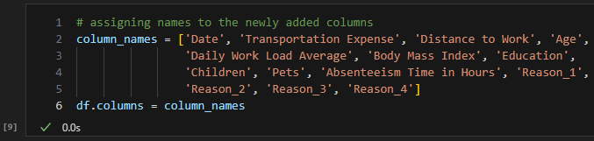
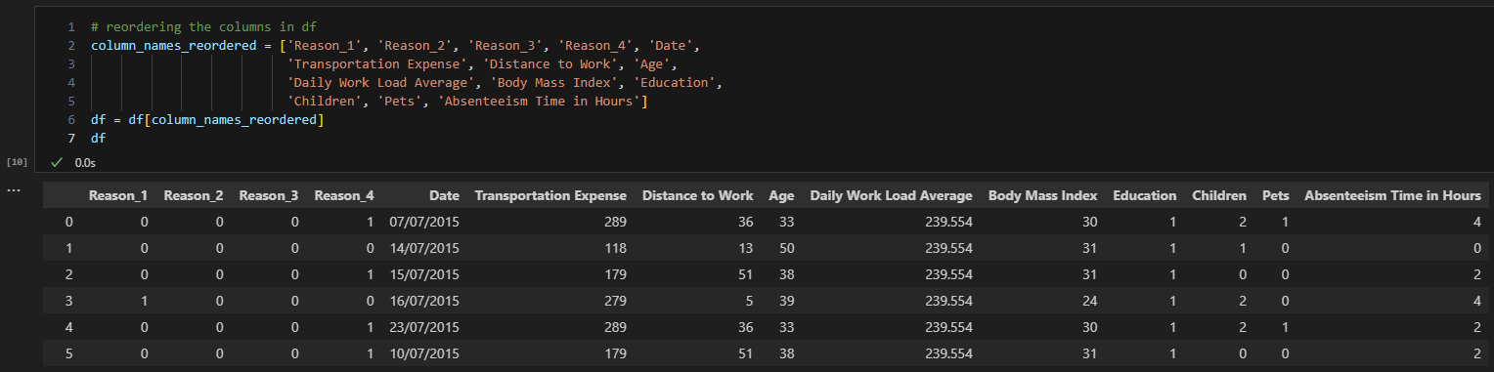
8. Assigning names to the newly added columns
9. Reordering the columns in df

Slide 13
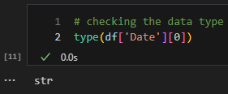
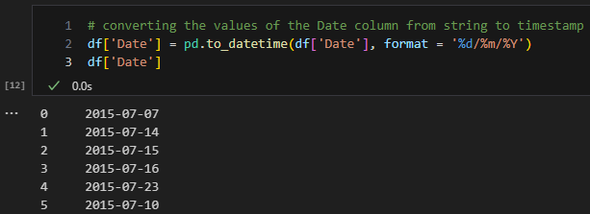
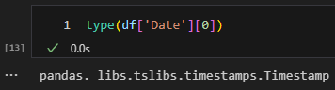
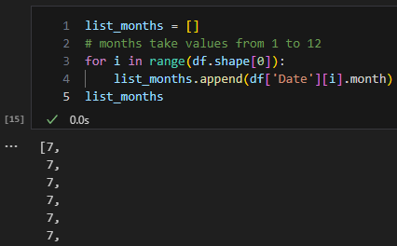
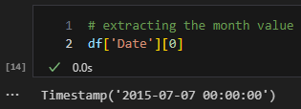
10. Converting the values of the Date column from string to timestamp
year-month-day
11. Extracting the month value

Slide 14
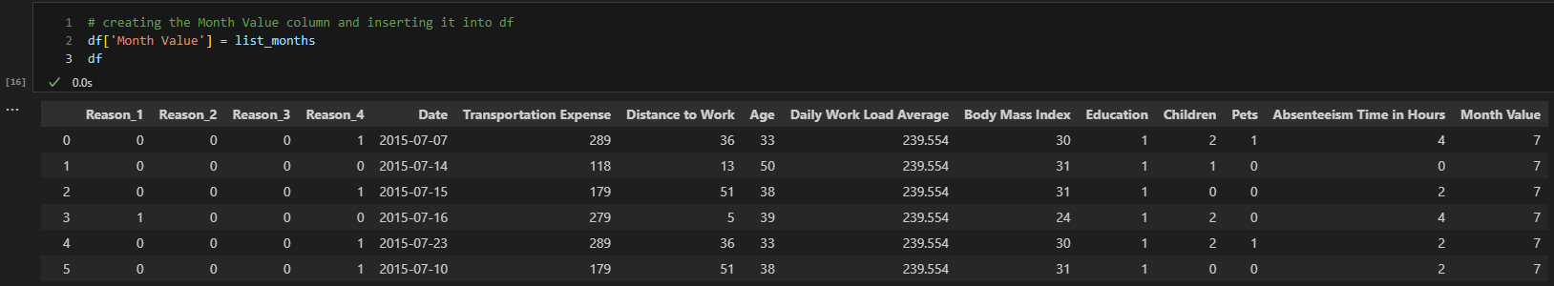
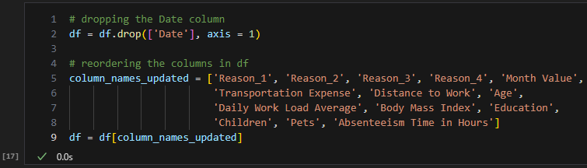
12. Creating the Month Value column and inserting it into df
13. Dropping the Date column and reordering the columns in df

Slide 15
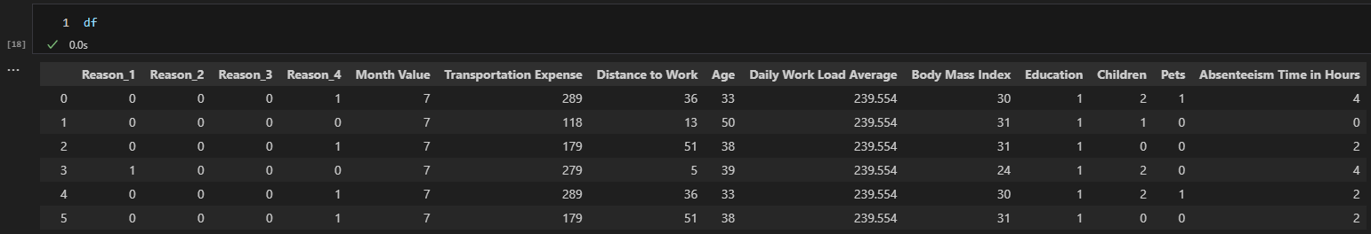
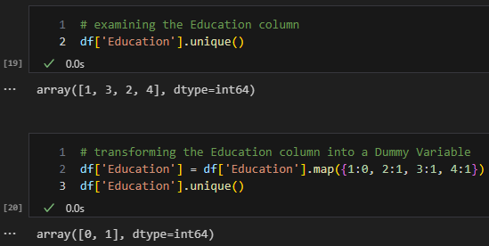
12. Examining the rest of the columns
No manipulation of the columns
Dropping the columns
A person works around 3-4 hours/day
13. Transforming the Education column into a Dummy Variable
Legend for Education values
1 – a person has High School Education only;
2 – a person has a Bachelor Degree;
3 – a person has a Master Degree;
4 – a person has a PhD.

Slide 16
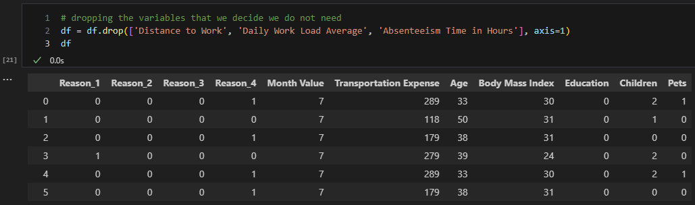

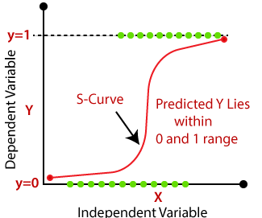
14. Dropping the variables that we decide we do not need
Preprocessed Data
Taking it in a ML algorithm
Logistic Regression = type of regression model whose dependent variable is binary.
Considering the values of all our features, we want to be able to predict whether the dependent variable will take the value of 0 or 1.
Dependent variable (target) = Absenteeism from work
Independent variable (predictors/features/inputs)

Slide 17
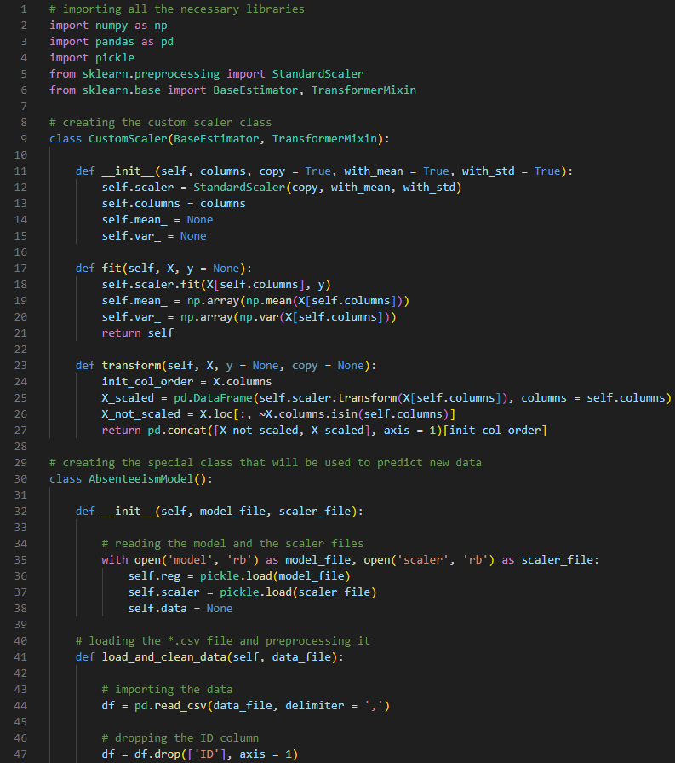
Statistical Analysis for making predictions
Creating the Absenteeism_module (*.py file) – STEPS:
Importing the necessary libraries:
NumPy -> numerical computing;
Pickle -> deserialization of the Model and Scaler files;
Scikit-Learn -> ML algorithms;
Creating the CustomScaler Class for data scaling;
Creating the AbsenteeismModel Class for making predictions:
Reading the Model and Scaler files, preprocessing the dataset, and making predictions.
Model -> trained ML model for making predictions
Scaler -> data scaling necessary for the ML model

Slide 18
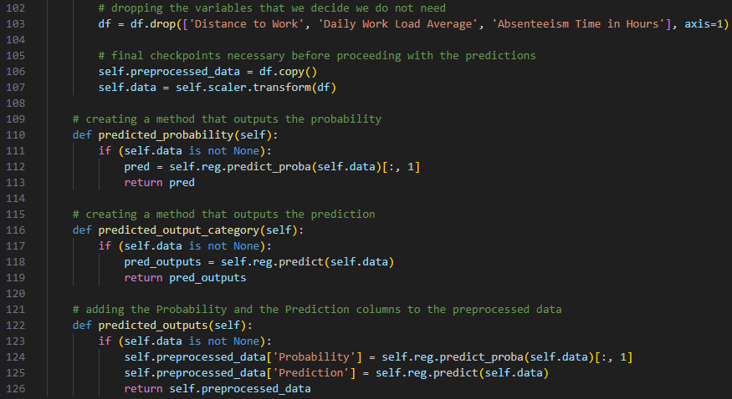
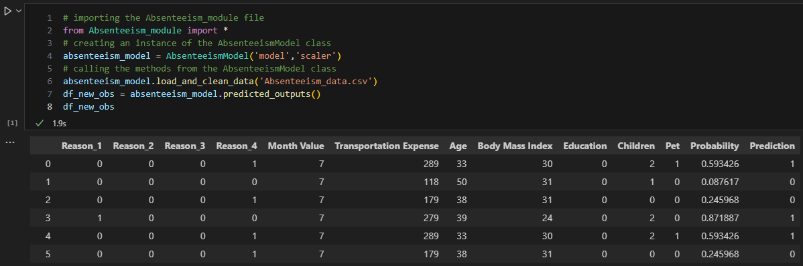
Running the Absenteeism_module
The Logistic Regression model calculates probabilities for each class and makes a prediction based on a threshold probability (0.5).
Probability of Absenteeism for more than 3 hours – values from 0 to 1:
0 = lowest probability of absenteeism;
1 = highest probability of absenteeism;
Prediction:
Probability < 0.5
-> Prediction of Class 0;
Probability >= 0.5
-> Prediction of Class 1.

Slide 19
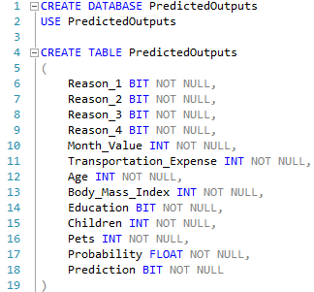

Integrating Python and SQL
SQL – used as a storage secure place for the predicted outputs -> At a later stage it would be easier to manipulate the data and extract useful information.
SQL Environment: Microsoft SQL Server Management Studio (SSMS)
STEPS:
1. Creating the Database and the Table in SSMS

Slide 20
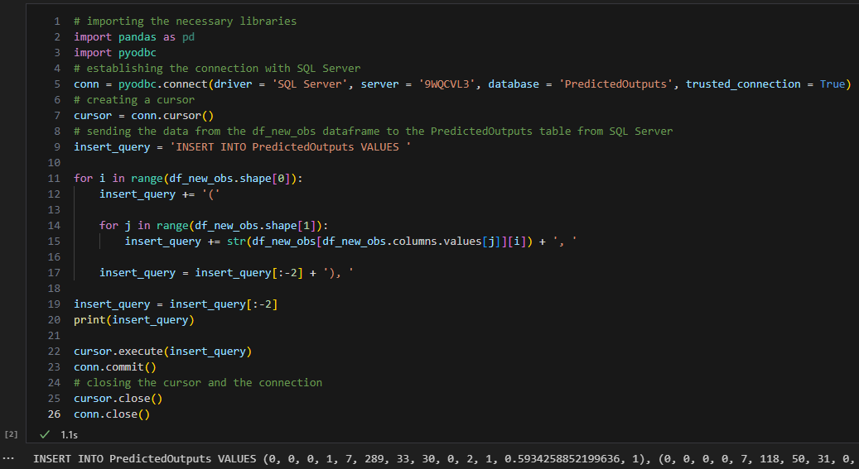
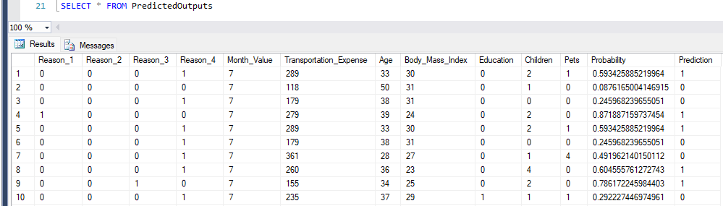

2. Sending the predicted outputs from Jupyter Notebook to SSMS
Connecting Python and SQL through pyodbc library
pyodbc -> enables Python apps to access databases using ODBC (Open Database Connectivity)
! If we had to type the entire INSERT statement manually in SSMS, it would take too much time.
Finally, saving the output as a *.csv file for loading it in Tableau.

Slide 21

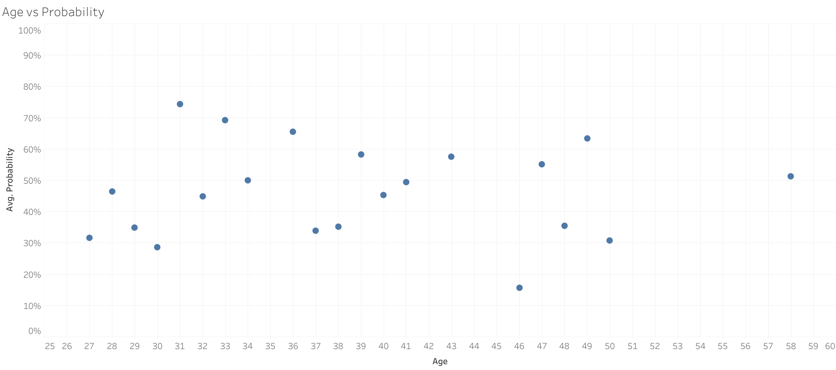
Visual Storytelling with Tableau

Slide 22
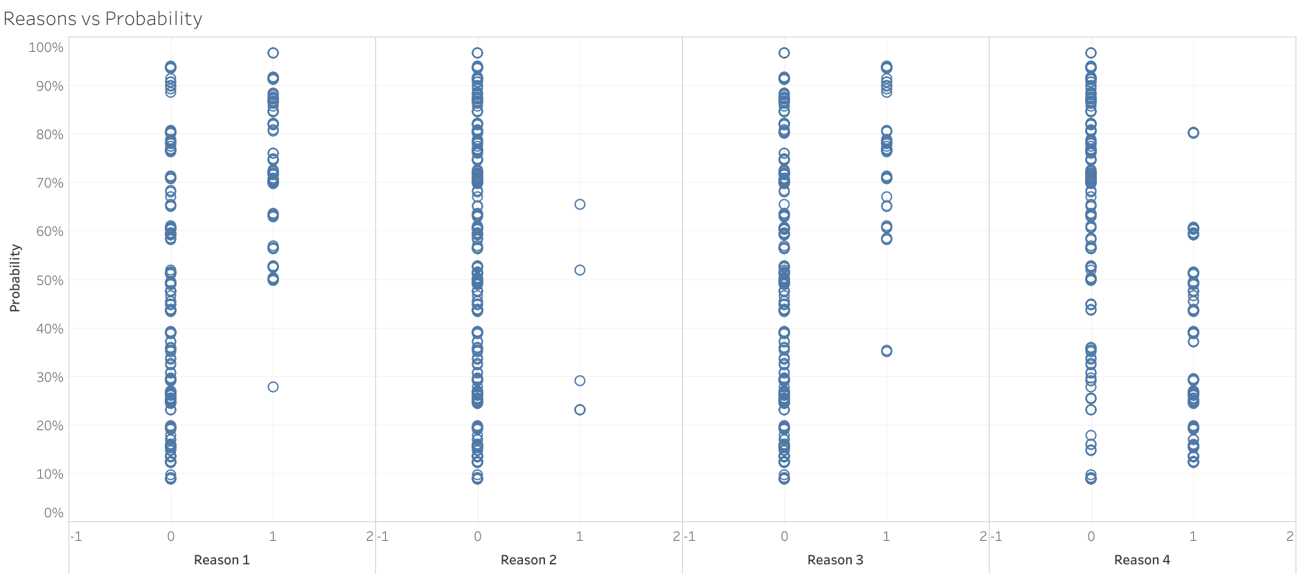

Slide 23
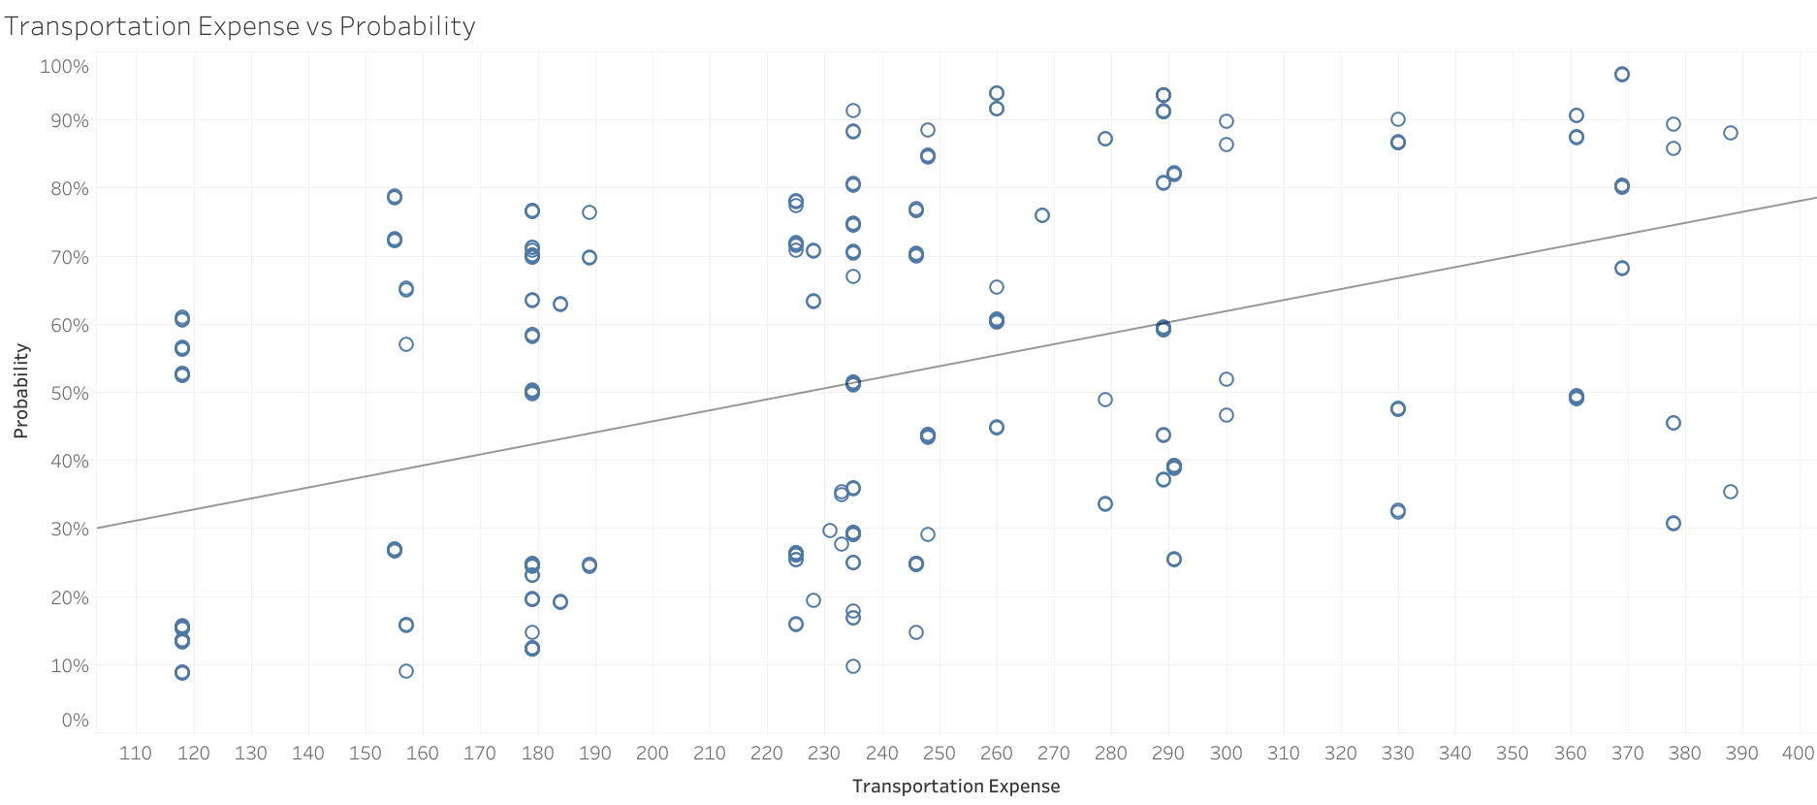

Slide 24


